Slide 1
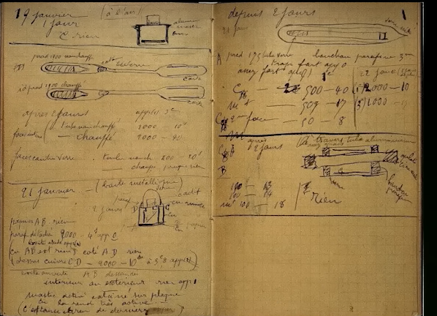
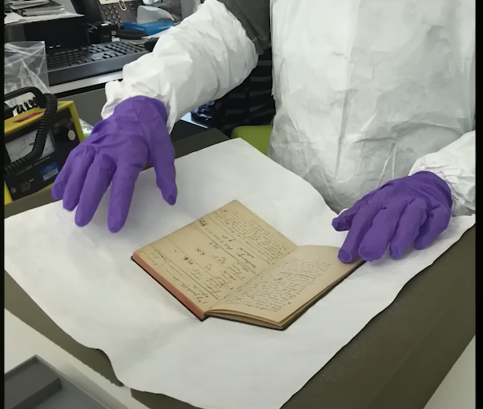

Slide 2
Queen of scientific world
Marie curie

Slide 3
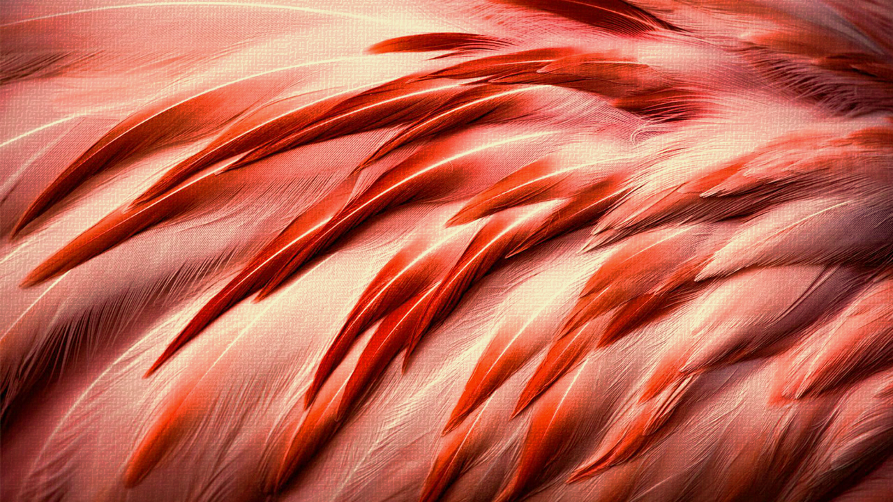
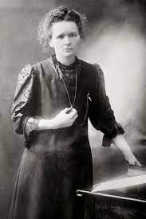
Marie curie

Slide 4
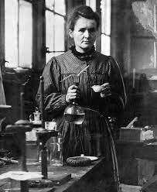
MARIE WAS A POLISH BORN SCIENTIST WHO MADE GROUNDBREKING CONTIBUTIONS TO THE FIELDS OF PHYSICS AND CEMISTRY.
Curie was born in Warsaw, Poland in 1867. She moved to Paris to study at the Sorbonne, where she earned degrees in physics and mathematics. While working on her doctoral research, she discovered two new elements: radium and polonium
Along with her husband pierre curie,who was a physics and chemistry teacher.

Slide 5
SACRIFICE SOMETHING TO ACHIEVE SUCEESS
She sacrifice her life to achieve success in her scientific research.
Curie’s research had a major impact on the development of x-ray technology,which revolutionized the field of medicine.She also made significant contributions to the understanding of radioactivity and its effects on the human body.
She discovered x-ray device which helps to a people a lot.
In her family everyone died because of radiation.
But ,she never ever give up her research on radium and polonium.

Slide 6
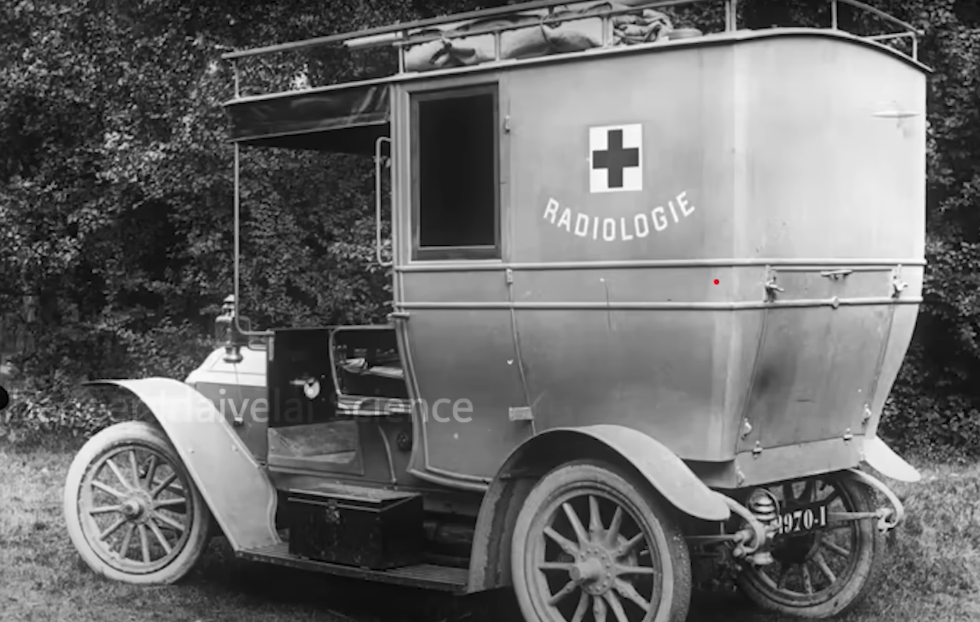

Slide 7
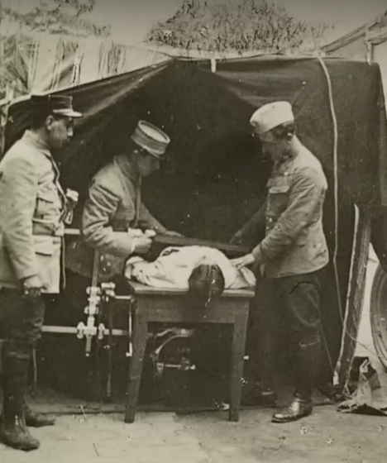
Curie saved life of thousands of soldiers in World War 1.
With the help of many womens.

Slide 8
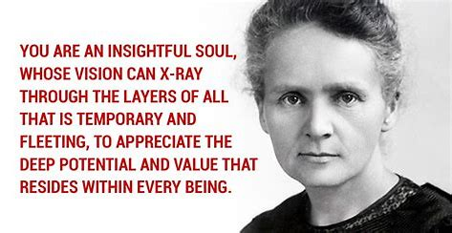
Curie died in 1934 at the age of 66 from complications related to her exposure to radiation during her research,
She was suffered by APLASTIC ANEMIA…

Slide 9

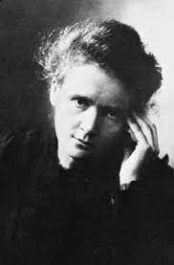
CURIE WAS THE FIRST
*The first women who has the degree in PHYSICS.
*The first women to graduate in FRANCE.
*The first women to obtain a chair in the Sorbonne .
*The first women faculty at the ECOLE NORMALE SUPERIEURE,which was a French university.
*The first women to obtain a nobel price in PHYSICS.
*The first women to obtain a nobel price in CHEMISTRY.
*The first and only women ,who got TWO NOBEL PRIZES.

Slide 10
THANK YOU
BY
SANJAI SK

